Slide 1
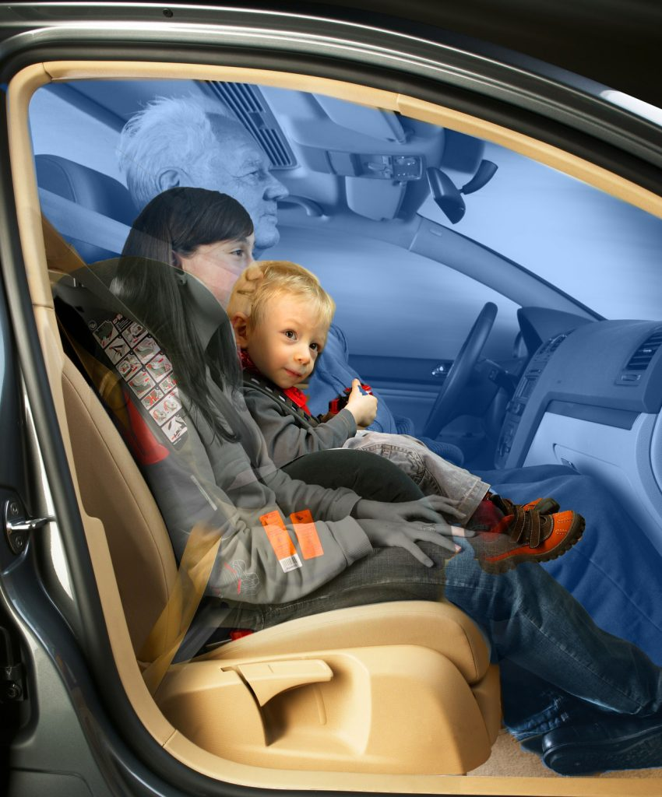
OCCUPANT AND CLASSIFICATION
Presented by,
1. VISHAL
2. ROSHAN
3. ANKIT
4. KAVYA SRI
5. AKSHATA

Slide 2
Contents
INTRODUCTION
CUSTOMER REQUIREMENT
SYSTEM BLOCK DIAGRAM
HARDWARE BLOCK DIAGRAM
FUNCTIONAL BLOCK DIAGRAM
SEQUENTIAL BLOCK DIAGRAM
TEST CASE

Slide 3
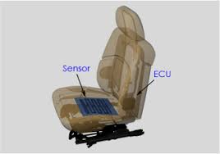
INTRODUCTION
Occupant classification system (OCS) is a system in which the front passenger seat is equipped with occupant detection and classification sensors that prevent the front passenger airbag from deploying if the system detects a non-living object occupying the seat then air bag is not deployed.
OCS is important part for making sure the air bag properly protects the passenger
This system includes CAN input , Hardware input and hardware output
This will enable you to check for proper operation to ensure a complete, safe and quality repair

Slide 4
CUSTOMER REQUIREMENT

Slide 5

SYSTEM BLOCK DIAGRAM
Seat Belt Status
Faulty status if input CAN message is missing
CAN I/P
Occupant Classification
(Processed data stored in Memory)
SW3 AND SW4 Combination
HW I/P
Occupant Status
CAN O/P
Passenger Airbag Disable/Enable

Slide 6
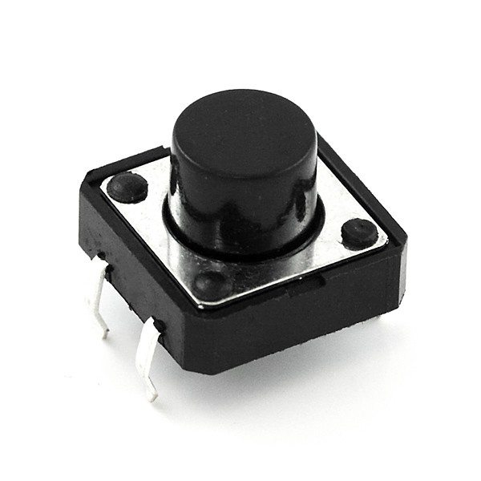


HARDWARE BLOCK DIAGRAM
Transceiver
RX TX GND VCC
RB3
RB2
GND
VCC
MICROCONTROLLER 2551
RB0
RA1
Mechanical
s/w 1
LED 1
Faulty status if input CAN message is missing
EEPROM
RB1
RA0
LED 2
Mechanical
s/w 2
Occupant Status
12V Power Supply

Slide 7
FUNCTIONAL BLOCK DIAGRAM
.
SET BAUDRATE
Setting CANCON=Config,
Baudrate=250,
BRGCON1,BRGCON2,BRGCON3
CANCON=Normal
CAN_INIT();
Configure
CANCON1 to config mode,
Set CANCON
1. EEPROM WRITE();
Write the received value
2. CAN_RX();
Receive the input from can Transmitter
VOID MAIN();
CAN_INIT()
EEPROM WRITE()
EEPROM READ()
SEAT BELT STATUS
5. EEPROM READ
READ(Address,state,value)
Read the value and stores the Address
4. SWITCH
00 Child Lamp ON
01 Adult 95% Lamp Off
10 Small Adult: Lamp Blink Every 5 Sec
11 Empty Lamp Blink Every 10 sec
3. CAN_TX();
Transmits the state value that is stored in EEPROM
6. SEAT_STATUS
IF RECIVED MSG AND ACESS MSG IS SAME ,LED=0 AND SWITCH();
ELSE LED=1;

Slide 8
SEQUENTIAL FLOW CHART
Start
Main()
Sys init ()
Can init ()
EEPROM Write
Receive
EEPROM Read
Seat Belt Status
00
Switch
01
10
11
Transmit

Slide 9
CAN INITIALIZATION
CAN INIT:
Setting up
Enable transceiver=1
CANCON1 to config mode
While ()
CANSTAT!=00
False
True
SET BAUDRATE
Setting CANCON=Config,
Baud rate =250,
BRGCON1,BRGCON2,BRGCON3
CANCON=Normal
Exit

Slide 10
RECEIVE
Start
RxBMCON=0x20
SIDH
SIDL
DLC=0x08
msg[0]=RxBnD0
To
Msg[7]=RxBnD7
Mask()
Filter()
Mask Enabling to
Filter
Msg[0]=RxFmSIDH
to
Msg[1]=RxFmSIDL
Exit

Slide 11
SEAT BELT STATUS
START
Receive()
If
(RECEIVED DATA==ACCEPTANCE DATA)
YES
NO
LED1=ON
LED1=OFF
SWITCH()
Exit

Slide 12
EEPROM WRITE
START
Switch()
EEADR=0x04
EEDATA=received data
Enable
EECON2=55;
EECON2=AA
Main()

Slide 13
EEPROM READ
Start
EEPROM WRITE
EEADR=0xF2
SEAT_BELT()
Main()

Slide 14
switch
Start
if(button==00)
True
if(switch==01)
LED=ON
True
if if(switch==10)
LED=OFF
Transmit()
false
True
LED=blinking for every 5 sec
LED=blinking for every 10 sec
Exit

Slide 15
TRANSMIT
Start
Enable CANCON=00
Enable TXBMCON to 0x77/0x73
Enable TXBMSIDH &
TxBMSIDL
Give the Actual DATA
Enable TXBMDLC to 8 bits
Give a Tx Request
EXIT

Slide 16
TEST CASES
TEST CASE | TEST CASE STEPS | TEST CASE RESULT
PRE CONDITIONS | ECU is powered ON | led should be ON
 | ECU is powered OFF | led should be OFF
CHEAKING SEAT BELT STATUS | message is received | led should be OFF
 | message is not received | led should be ON
CONNECTION LED AND SWITCHES | Turning SW 1 & SW 2 OFF | LED should be ON(child)
 | Turning SW 1 OFF & SW 2 ON | LED should be OFF(Adult)
 | Turning SW 1 ON& SW 2 OFF | LED should be blink in evry 5 seconds(small adult)
 | Turning SW 1 ON& SW 2 ON | LED should be blink in evry 10 seconds(empty)
TRANSMITTING SEAT BELT STATUS & OCCUPANT STATUS TO ECU FOR AIR-BAG DEPLOYMENT | Checking seat belt status message is received & person occupied is child | AIR-BAG status should not be deployed
 | Checking seat belt status message is not received & person occupied is adult | AIR-BAG status should be deployed
 | Checking seat belt status message is received & person not occupied is small adult | AIR-BAG should not be deployed
 | Checking seat belt status message is not received & person not occupied | AIR-BAG should not be deployed
 | storing data(write) in EEPROM | read the data written in EEPROM

Slide 17
Thank you

